Slide 1
Aztec Mythology
Ayumi Sakamoto, Jewon Moon, Jihui Lee, Yousef Alharbi
Instructor : Olivia Stark
UCTP-Prep
June 11,2015

Slide 2
Outline
Introduction
- History of Aztec Myth
- Culture of Aztec
- Religion of Aztec
Definition of Myth
Conclusion
Reference

Slide 3
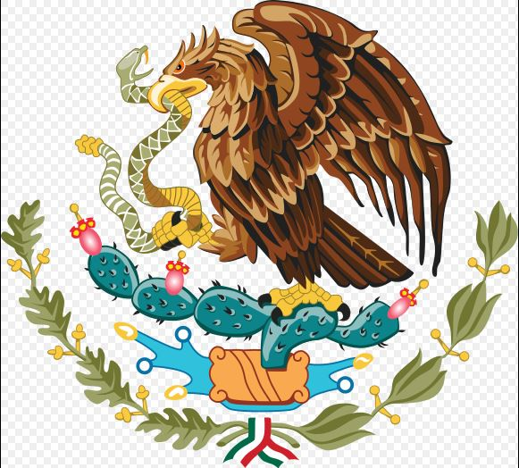
History of Aztec Myth
Why people turned into monkeys and spread throughout the hills?
How to keep the universe in balance?

Slide 4
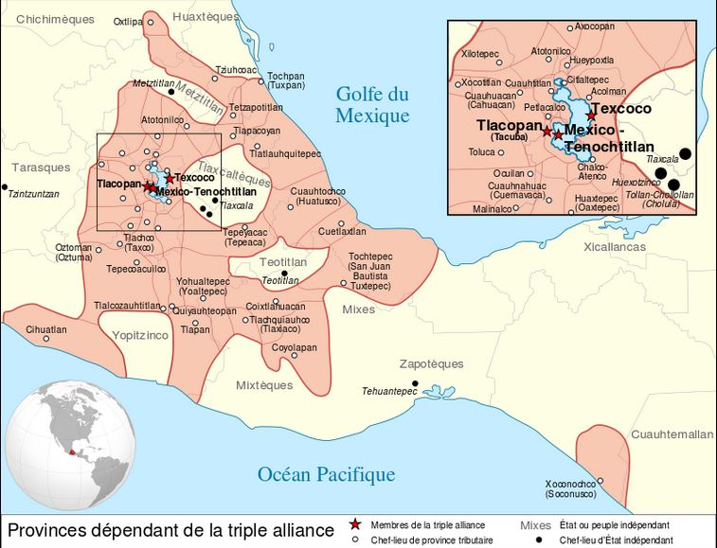
Culture of Aztec
The foundation for later Aztec culture was laid.
The complex civilizations of Mesoamerica.

Slide 5
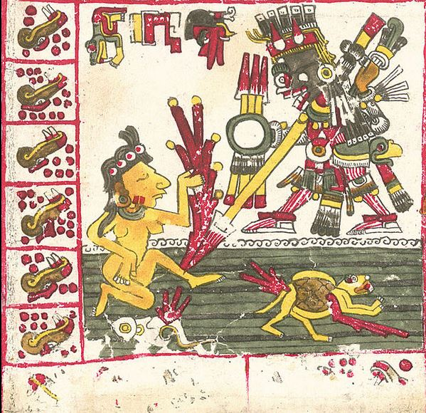
Religion of Aztec
Aztec religion was greatly influenced.
The Aztec had became the reigning.

Slide 6
Definition of Myth
Who is Quetzalcoatl?
Meaning of the Name
- Quetzal : a bird of beautiful feather
- Coatl : snake

Slide 7
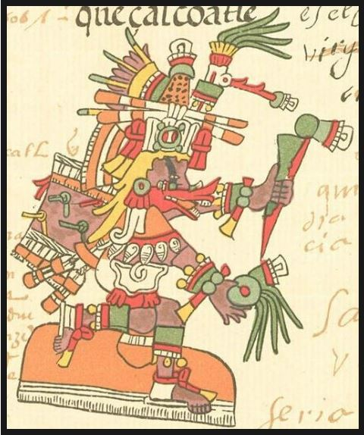
Definition of Myth
Characteristic of Quetzalcoatl.
- The god of Feathered
Serpent

Slide 8
Definition of Myth
Background of the fifth sun.
Who became to Sun and Moon?
- Sun : Tecciztecatl
- Moon : Nanauatl

Slide 9
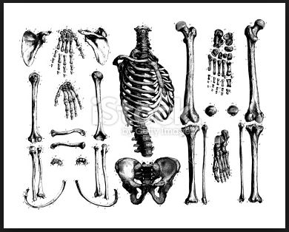
Definition of Myth
How to Quetzalcoatl created people?
- The mythology of human
creation.

Slide 10
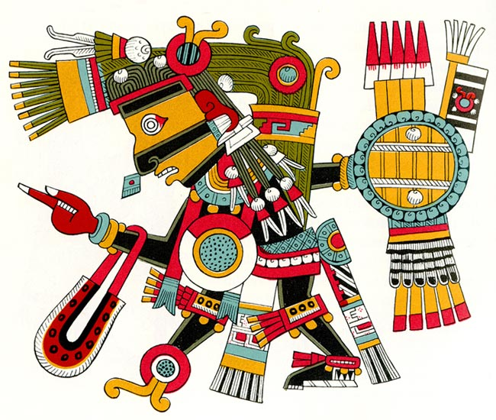
Definition of Myth
Quetzallcoatl’s sad story?
- tricked by Tezcatlipoca.
- kicked out the world.

Slide 11
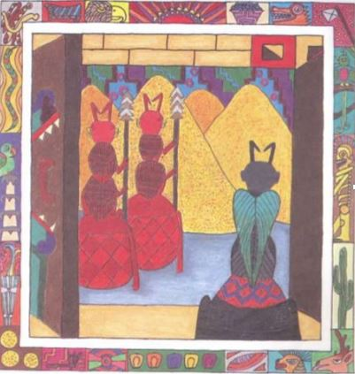
Definition of Myth
How to spread seeds all over the world?
- turned into an ant.
- Tlaloc exploded ants'
storage.

Slide 12
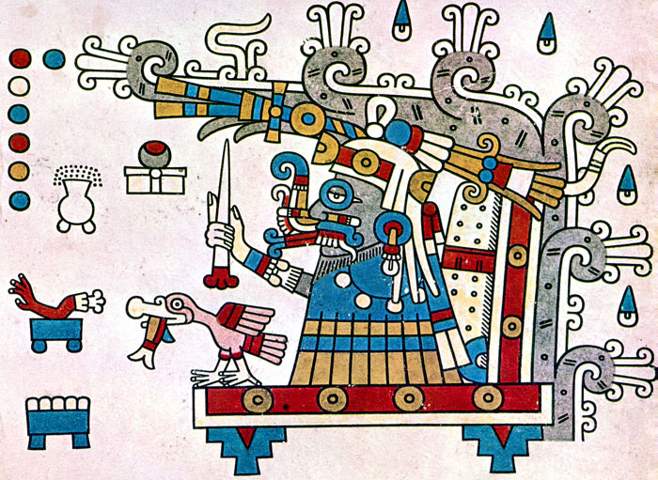
Definition of Myth
Who is Tlaloc?
- Aztec’s rain god
- Aztec’s agriculture god

Slide 13
Conclusion
What connect between Aztec Myth and culture?
- Development of architecture
- Influence on arts of Aztec
- Agriculture of Aztec

Slide 14
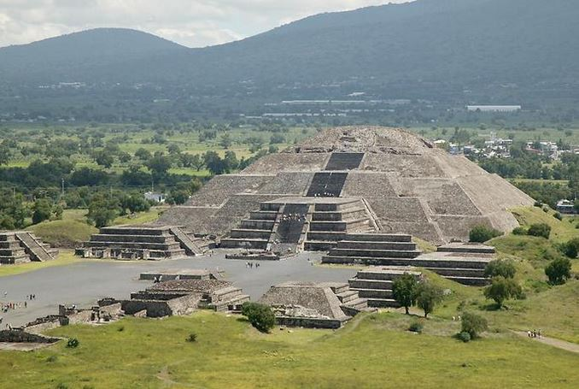
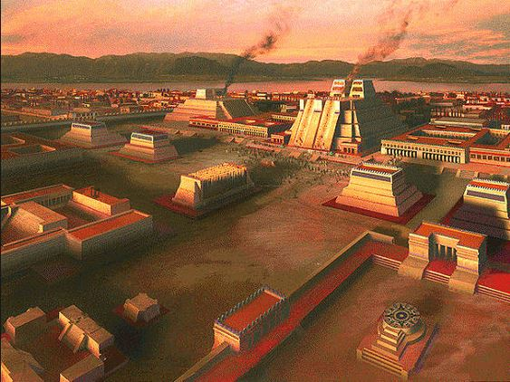
Development of architecture
Tenochtitlan was capital of Aztec.
It was Island.
There were a lot of temples.

Slide 15
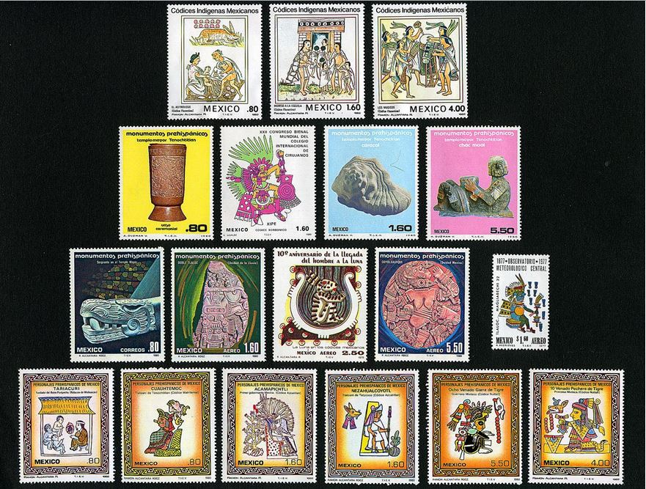
Influence on arts of Aztec
Mexico was governed by Spain for 300 years.
The government and citizen tried to revive the culture and myth.

Slide 16
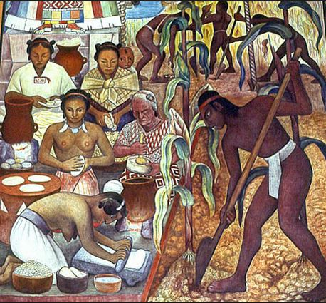
Agriculture of Aztec
Their main food was corn.
Aztec people ate human meat.
Cannibalism was just their culture.

Slide 17
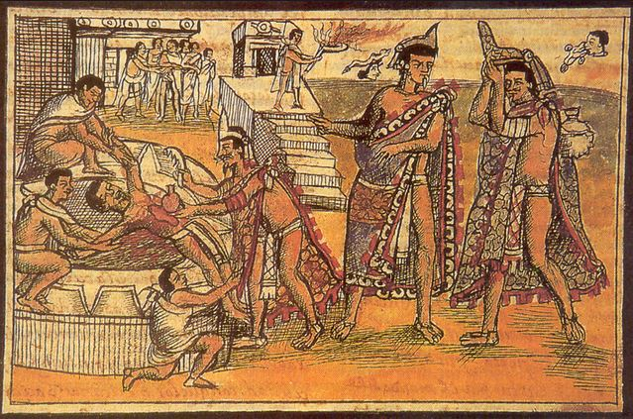
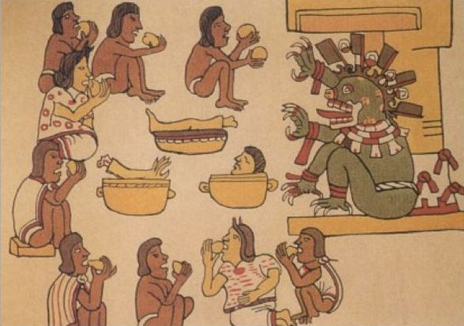

Slide 18
References
Myths and Legends of the world. Aztec Mythology. N D. 10 June 2015.
- http://www.godchecker.com/pantheon/aztec-mythology.php
Ancient History. Tenochtitlan. 20 September 2013. 10 June 2015.
- http://www.ancient.eu/Tenochtitl%C3%A1n/
Aztec-History.com. Aztec Creation Story. N D. 10 June 2015.
- http://www.aztec-history.com/aztec-creation-story.html
Aztec Gods and Religion. Aztec Civilization. N D. 10 June 2015.
- http://www.crystalinks.com/aztecgods.html

